Slide 1

Regression-omics
Project 2

Slide 2


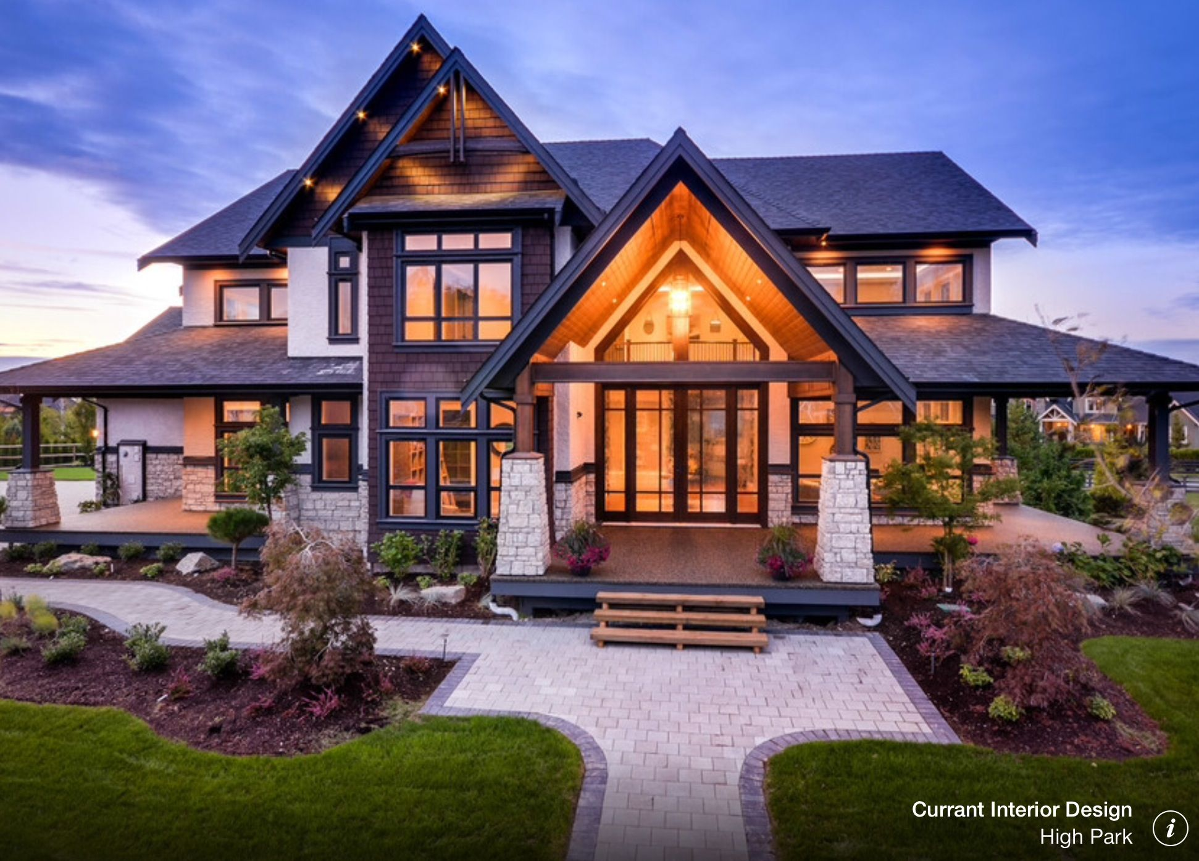








Have you ever looked at a nice house and said,
“I wonder how much that’s worth?”
Perhaps you’ve fretted about the value of your own property, or got into a heated argument with a relative/potential buyer on the perceived price of your property.
= $?
Notes:
Have you ever looked at a nice house and said, “I wonder how much that’s worth?”
Perhaps you’ve fretted about the value of your own property, or got into a heated argument with a relative/potential buyer on the perceived price of your property.
What if there was a simple and effective solution to all of this?
Here’s what us data scientists at MetaQuark Realty aim to achieve - a simple solution so that you, the home buyer/owner to accurately predict the price of a property.
Back of the mind of any home owner/buyer
Not having a clear idea of the price of the property → Anxiety, Stress, Arguments

Slide 3









There are are many features that determine how much a home can fetch!
An Outside View* involves ignoring these details and using an estimate based on a class of roughly similar previous cases.
Your Inside View involves making predictions based on your understanding of the details of the process - not that it’s wrong, it’s just that it’s often biased!
BIAS
Excerpt from Daniel Kahneman - Thinking Fast and Slow: The outside view asks if there are similar situations that can provide a statistical basis for making a decision. Rather than seeing a problem as unique, the outside view wants to know if others have faced comparable problems and, if so, what happened
Notes:
Magnifying Glass picture
An Inside View on a topic involves making predictions based on your understanding of the details of the process. - not that it’s wrong, it’s just that it’s often biased
An Outside View involves ignoring these details and using an estimate based on a class of roughly similar previous cases.

Slide 4





Problem Statement
Ames dataset
Develop Model
Predict Price
There are are many variables that determine how much a home can fetch.
Using the Ames (IA) dataset (train, test), we want to find out which variables matter for home sale prices and produce accurate sale price predictions.
This model will help provide the Outside View*, helping to reduce information asymmetry between potential home-buyers, home-sellers and real estate agents.
Notes:
Outside View = ‘Simple to understand’, ‘starting point, unique features they may have to adjust for later.
Ames housing dataset
Historical pricing of many properties in our fine city
Very extensive
Takes into consideration many important features, including, but not limited to:
Overall quality of the property
Number of rooms
Which neighborhood the property is in
Age of the property and renovated features
And many more!

Slide 5
Overview
Defining our problem statement (Zhewei)
Overview of our datasets / Exploratory data analysis (EDA) (Wee Hong)
Cleaning our data (Darren)
Processing our data (DJ)
Model Selection (Darien)
Conclusion (Darien)
Notes:
Model Selected - LASSO Regression - Best RMSE Values
Different metrics
LASSO simplest to understand
Which LASSO have the biggest coefficients - Top 5 most positive and negative - Strongest Features

Slide 6
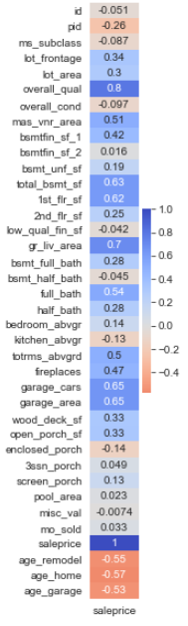
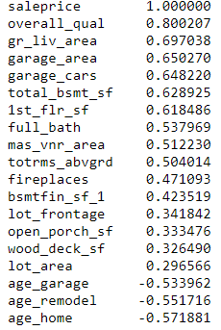
Overview of our dataset
Correlation matrix (Sale-price)
Selected features
Dataset Snapshot
80 features + 1 target variable (‘sale-price’)
42 qualitative columns vs. 38 quantitative columns (incl. ‘id’, ‘pid’)
Brief Process Taken
Data Cleaning and Discovery
Descriptive Statistics to ensure we have good dataset to develop a linear model
Features Engineering and Selection (illustrated in diagram on the right)
Model Development

Slide 7
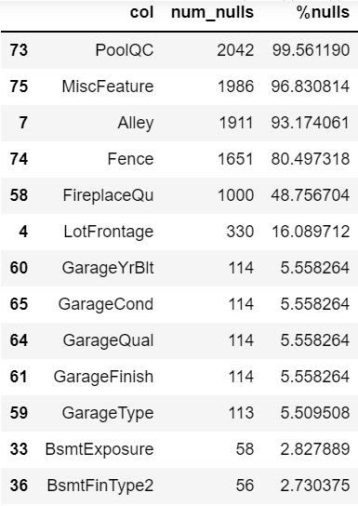
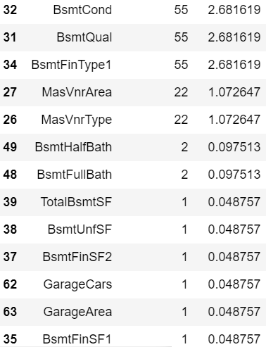
EDA Overview - Missing Value Summary
- Some columns has significant percentage of missing value like PoolQC and others
- Further investigation was done and found that they aren’t exactly missing value but accurate representation of certain categorical feature not being available
Notes:
Outside View = ‘Simple to understand’, ‘starting point, unique features they may have to adjust for later.

Slide 8
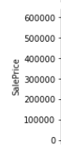
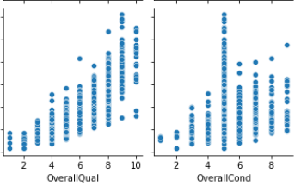
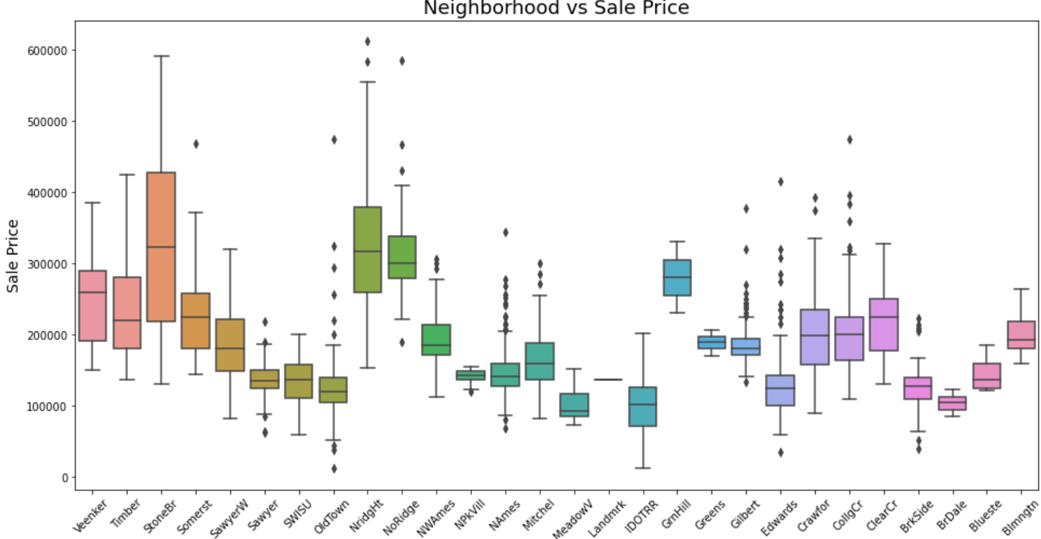
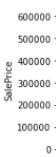
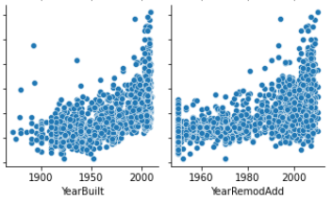
EDA Overview - Bivariate Relationship
- Doing bivariate analysis, we were able to identify relationship between some columns against sale price
- We were able to identify interesting relationship, not only for continuous variable but also for categorical one like above
Notes:
Outside View = ‘Simple to understand’, ‘starting point, unique features they may have to adjust for later.

Slide 9
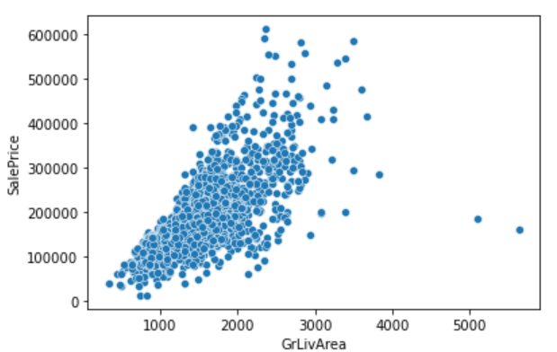
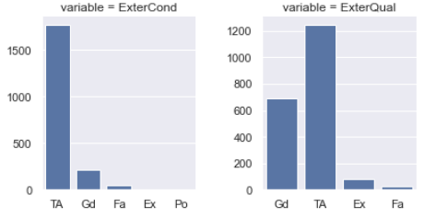
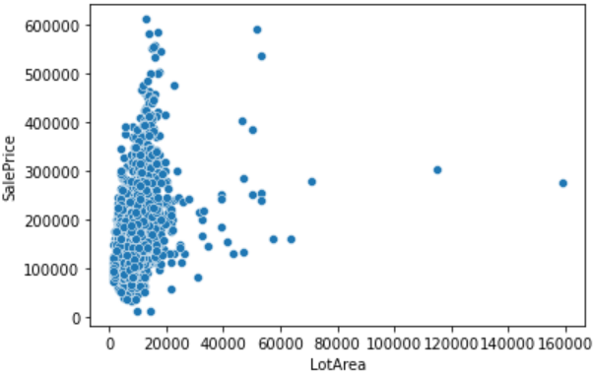
EDA Overview - Outlier & Non-Numerical Data
- We also observed outlier in some features which must be resolved to avoid problem during model training
- We have quite a number of categorical column that needs to be converted to numerical since model can only understand numbers
Notes:
Outside View = ‘Simple to understand’, ‘starting point, unique features they may have to adjust for later.

Slide 10
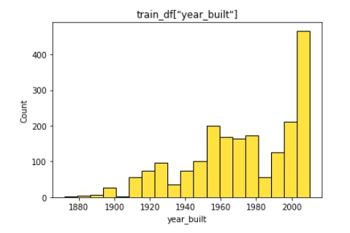
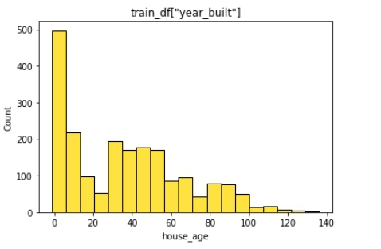
Cleaning up datasets
Convert features
Year_built -> house_age
year_remod/add -> reno_age
Garage_yr_blt -> garage_age
Notes:
So as to allow the model to have a better understand of what the feature is

Slide 11
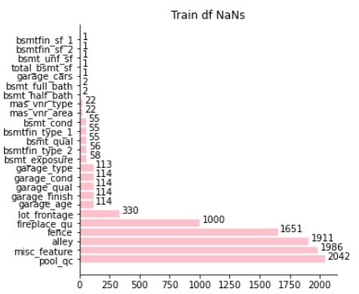
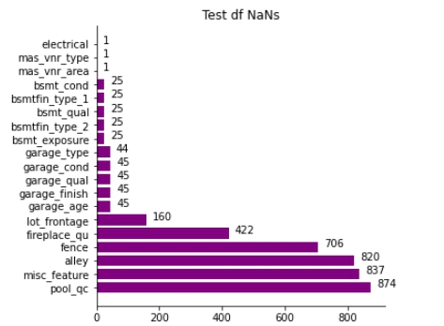
NaNs
Data description states that NaNs represent the non-existence of a feature.
Replace quantitative NaN with 0, qualitative with None.

Slide 12
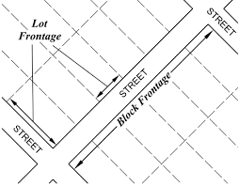
Lot Frontage
By definition, lot frontage is the width of the house that is facing the street. Therefore, it does not make sense to replace 0 for lot frontage NaN.
Replace NaN with lot frontage mean, 69

Slide 13

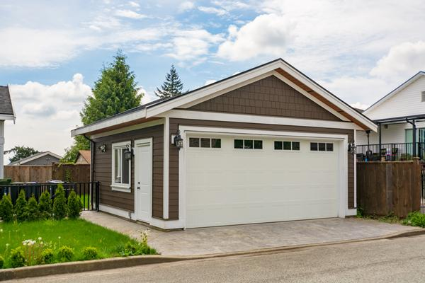
Garage Age
Domain knowledge states that the newer something is, the higher price it can fetch. By replacing NaN garage age with 0, we are saying that it has a very new garage, instead of not having a garage. This will heavily affect the fetching price of the house
Replace NaN with garage_age mean, 29

Slide 14
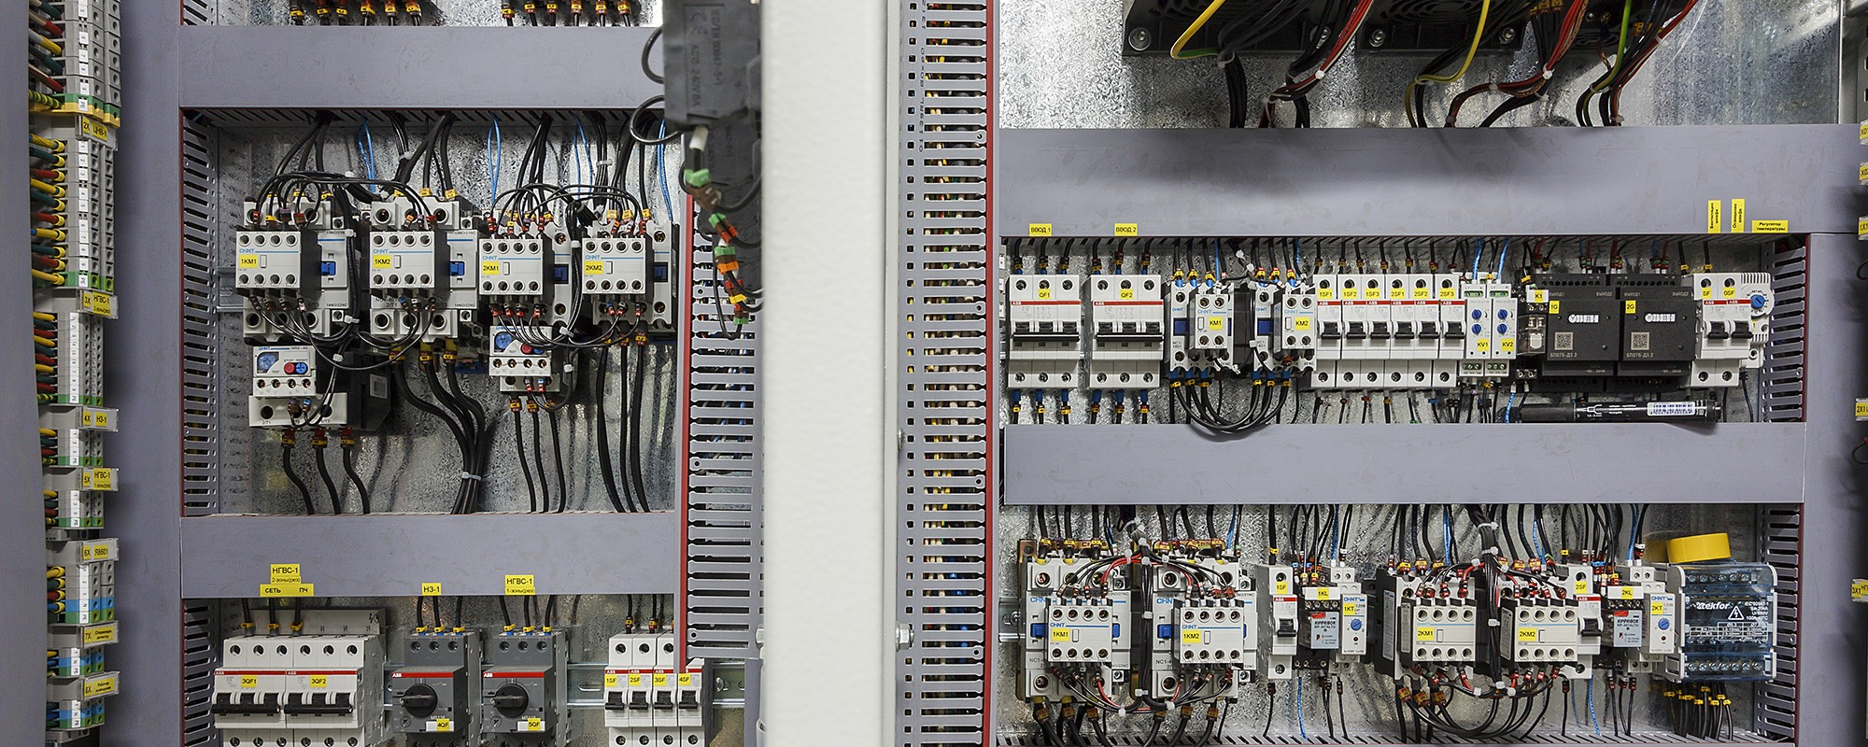
Electrical
All modern houses have electricity. It does not make sense that a house does not have any electrical.
Replace NaN with the mode ‘Sbrkr’
Replace remaining NaNs with None

Slide 15
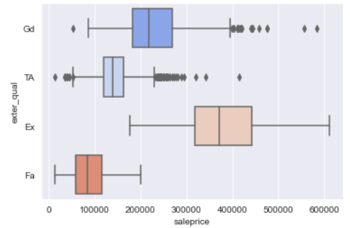
Do we account for ordinal variables?
We have found that converting ordinal features to a numerical scale (0-5) does not significantly improve the model (in terms of R-squared or RMSE).
We posit that ordinal features here… do not assume a linear relationship with sale-price. One-hot encoding them may also a be suitable (perhaps more efficient) approach

Slide 16
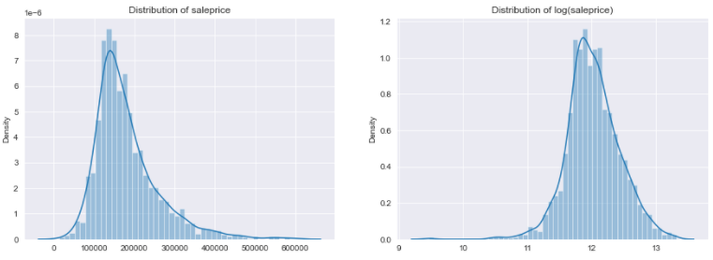
Adjusting for skewness
These need to be log-transformed
np.log1p allows us to account for very small values
Right-skewed
(Fat right-tails)

Slide 17
Model Selection & Evaluation Metrics
Multiple Linear Regression with Regularization
175 Features were included in the model
Many iterations of feature which may cause: - Overfitting - Multicollinearity - Computationally intensive
Performed Linear Regression, Ridge and Lasso

Slide 18
Evaluation Metrics
 | Model Type
Scoring Metric | Simple Linear | LASSO | RIDGE
R2 | 0.93 | 0.94 | 0.94
RMSE | 19909.82 | 19574.17 | 19250.99
R2: Coefficient of Determination
RMSE: Root Mean Square Error

Slide 19
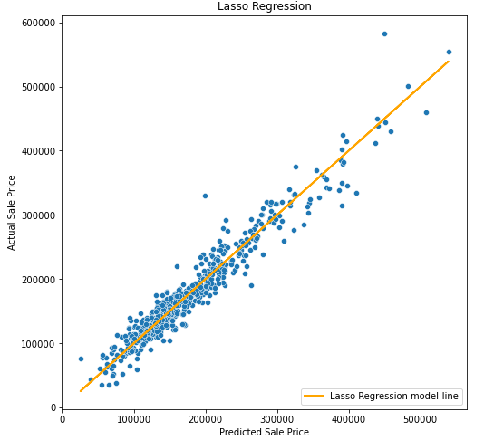
Lasso regularization
Lasso can set coefficients to absolute zero compared to Ridge which never set the value of coefficient to zero.
Helps to reduce features that are not relevant.
Top 5 Features | Positive Coefficient
Gr Liv Area | 0.12
Overall Qual | 0.09
Functional (Typical) | 0.05
BsmtFin SF 1 | 0.04
MS Zoning (RL) | 0.03
Top 5 Features | Negative Coefficient
Remodel Age | -0.04
Exter Cond (Poor) | -0.04
KitchenQual (TA) | -0.05
Home Age | -0.03
Kitchen Qual (Gd) | -0.03

Slide 20
Conclusion:
Recommendations:
The model will perform best when having to predict houses within the range of $100k to $300k
To fetch a better sale price, we will need to maintain/improve features that have high coefficients.
Distance to amenities.
Crime rate / accident around the neighbourhood.

Slide 21
Q&A

Slide 22
Appendix

Slide 23
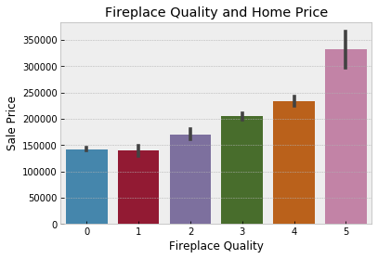
Feature Engineering & Selection
Logarithmic Distributions
Categorical Features Handling
Generation of new features like “House Age”
One-hot encoding for nominal features

Slide 24
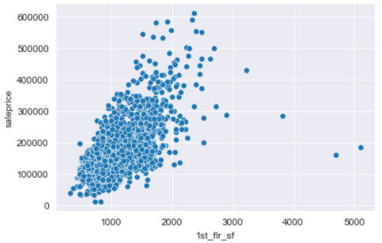
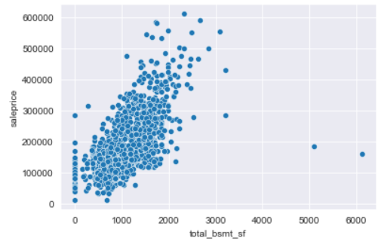
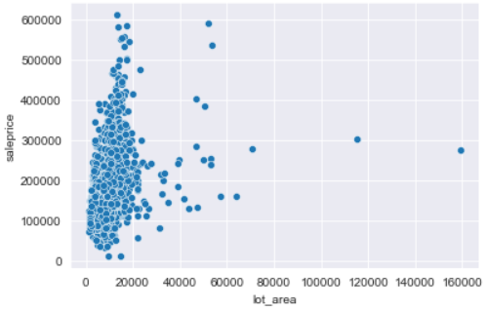
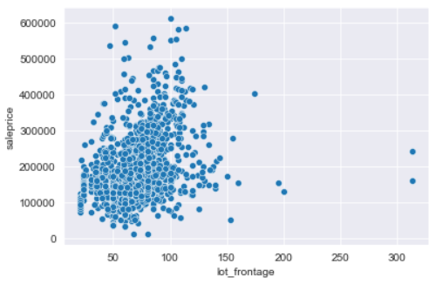
Cleaning our train data; Removing outliers
Outliers will need to be removed in order for our supervised machine learning models to work
These can be inspected manually or filtered via kurtosis/skewness thresholds

Slide 25
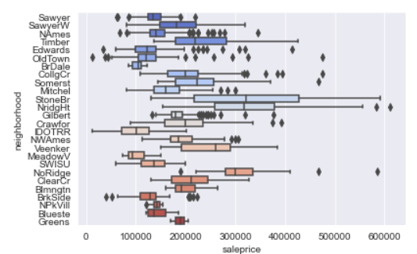
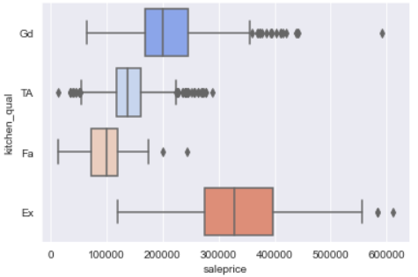
Considerable variance among some categories

Slide 26
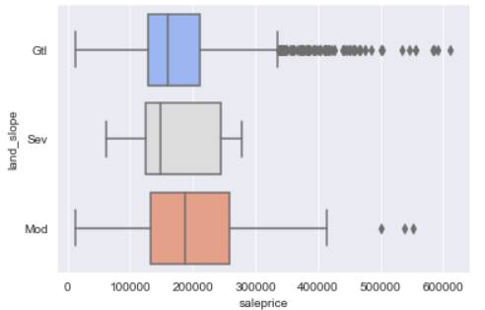
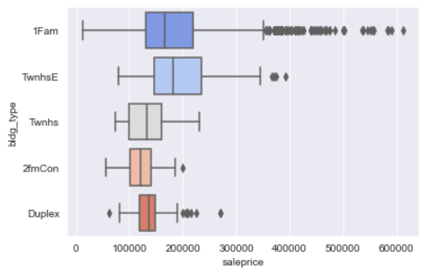
And… not so much variance in some

Slide 27
Log-transformations and StandardScaler()
Standardization does not change the skew of the distribution. What it does is to transform the values so that the overall distribution has μ=0 and σ2=1. The shape of the actual distribution remains unchanged.
Many elements used in the objective function of a learning algorithm assume that all features are centered around zero and have variance in the same order. If a feature has a variance that is orders of magnitude larger than others, it might dominate the objective function and make the estimator unable to learn from other features correctly as expected.
When a feature does not follow a linear distribution, it would be unwise to use the mean and the standard deviation to scale it. Log-transformation changes the skew of the distribution, and is useful when you deal with right-skewed distributions (fat right tails).

Slide 28
links
Lot frontage definition
https://www.gimme-shelter.com/frontage-50043/

Slide 29
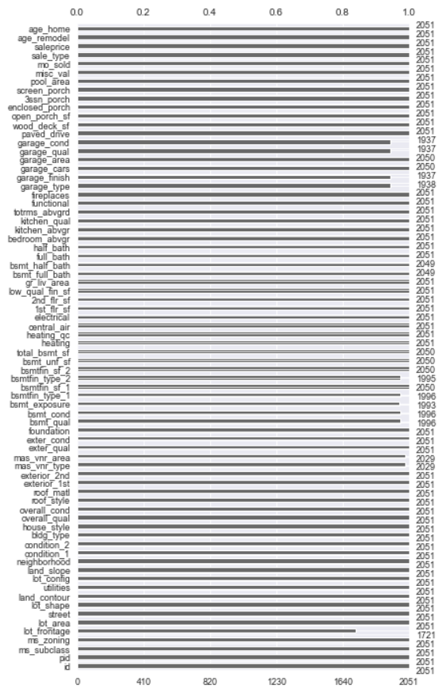
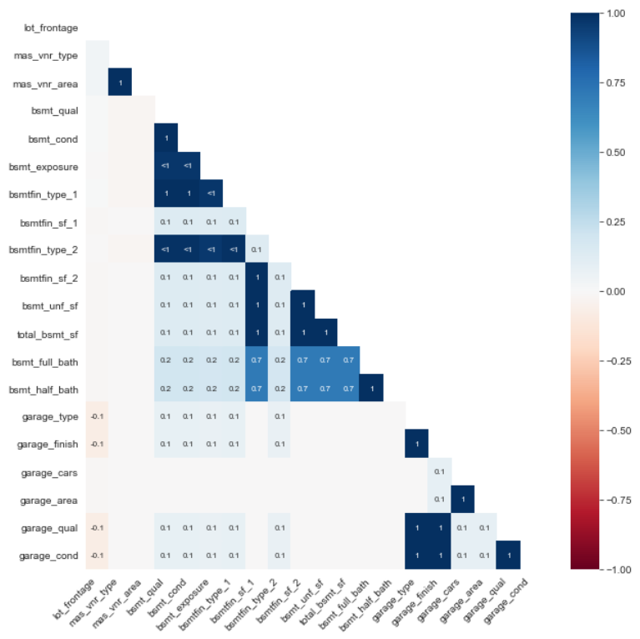
Handling missing values
Several quantitative and qualitative features are missing
Some of them do not appear to be missing completely at random

Slide 30
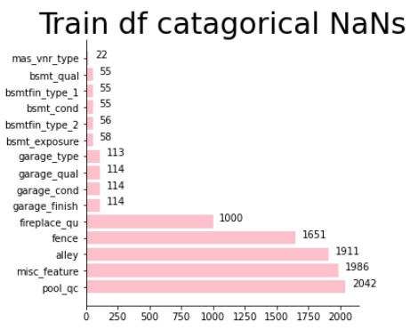
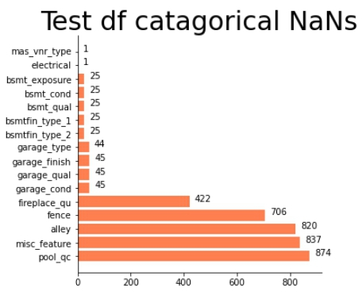
Qualitative Variables

Slide 31
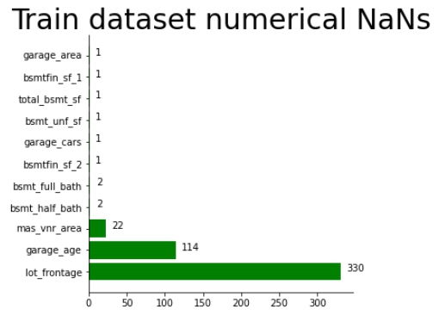
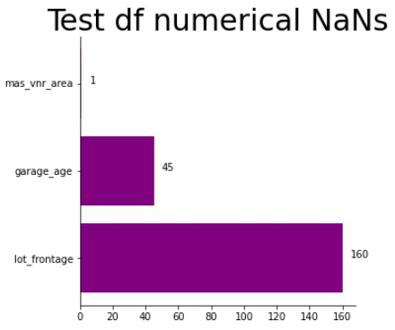
Quantitative Variables

